Slide 1


Adding Okta SSO to my website
by Robert Nicolo

Slide 2
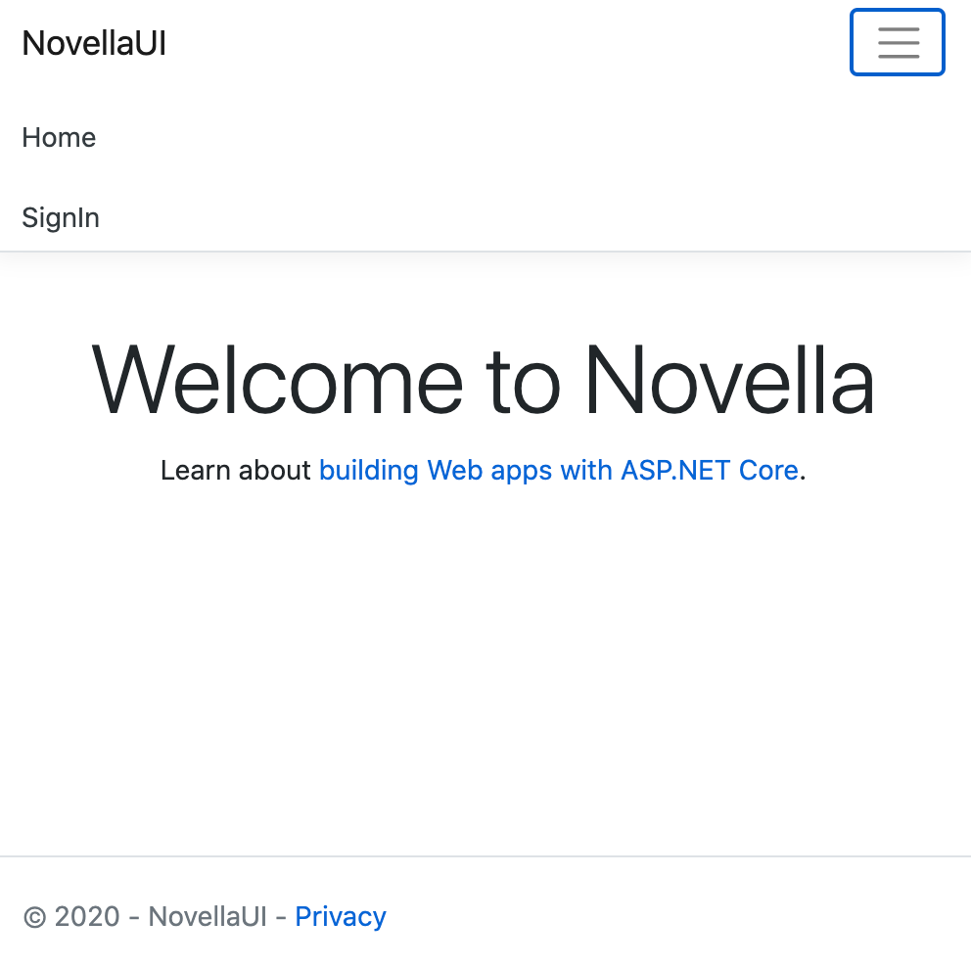
What was built
Website built for hypothetical Novella company
Built on a .Net tech stack including ASP.NET Core and Visual Studio

Slide 3
How it was built
Created a project in Visual Studio using the ASP.NET MVC website template
Followed the documentation on developer.okta.com starting with this page: https://developer.okta.com/docs/guides/build-sso-integration/overview/

Slide 4
Sign in link
Added sign in functionality
Clicking on the SignIn link redirects to the Okta sign in page

Slide 5
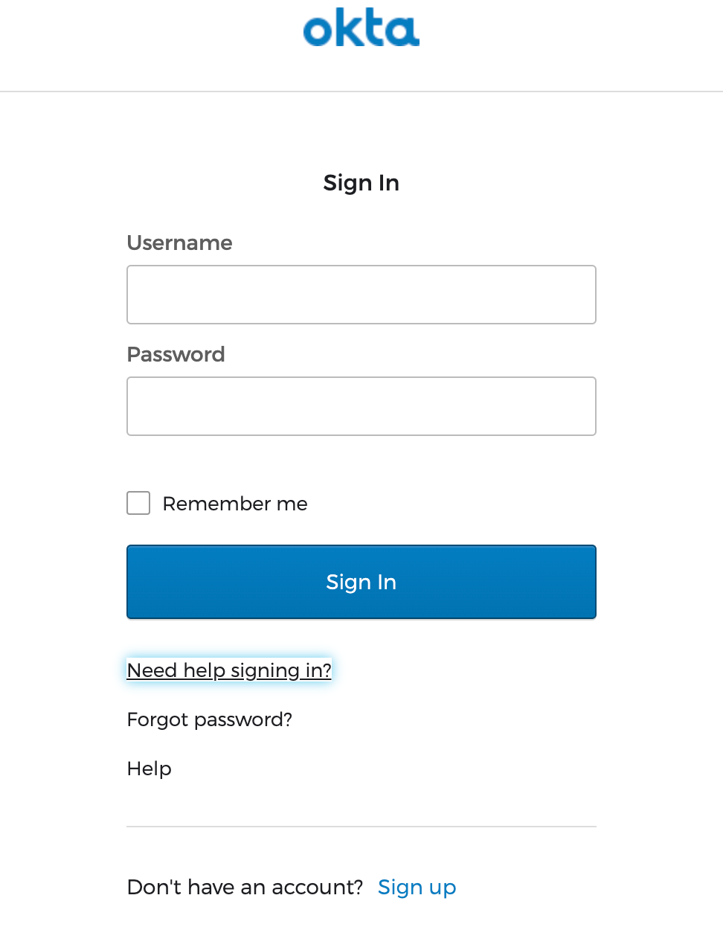
Okta sign in page
Sign in page supports the following:
MFA
New user registration
Password reset

Slide 6
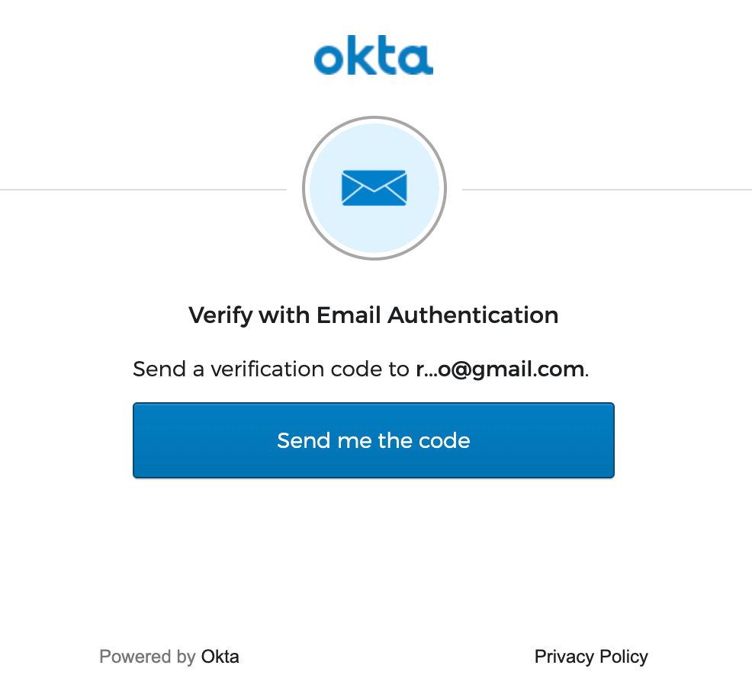
Sign in with multi factor authentication (MFA)
Screenshot to the right shows the MFA support

Slide 7
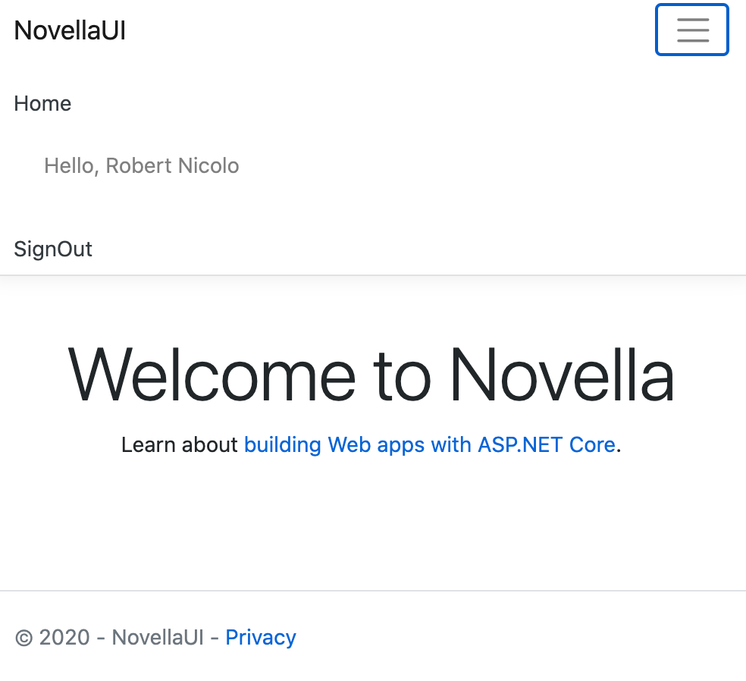
Sign In functionality
Displays username
Username is pulled from: User.Identity.Name in _Layout.cshtml

Slide 8
Sign out functionality
The SignOut link signs the user out and redirects back to the home page

Slide 9
What I liked about the experience
Adding additional features such as MFA, and user self service required no code change
The Okta admin console was relatively easy to use for the following tasks:
Adding applications, people, and groups
Setting up MFA and Self Service Registrations
Minimal ASP.Net integration points

Slide 10
What I didn’t like about the experience
Not having access to a troubleshooting guide to resolve errors
Some of the error messages were not clear
Unsure which integration type to choose (eg. SSO Page, widget, etc)
Not clear at times what were the next steps when finishing a guide
The documentation was lacking guidance in several areas. See Okta integration doc recommendations for a list of recommended changes.

Slide 11
If I had more time I would explore ...
Authorization: Creating an Admin group and assign people to that group. The site would allow such “Admins” additionality funcationalty.
Okta Widget: Successfully integrate the Okta widget

